Slide 1
Linked List
Single Linked List

Slide 2
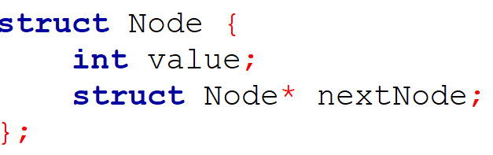
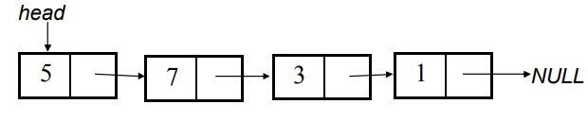
Single Linked List
A linked list is a linear collection of data elements (called nodes), where the linear order is given by means of pointers.
Each node is divided into 2 parts:
1st part contains the information of the element.
2nd part is called the link field or next pointer field which contains the address of the next node in the list. struct node

Slide 3
Single Linked List
Insert: Add a new node in the first, last or interior of the list.
Delete: Delete a node from the first, last or interior of the list.
Search: Search a node containing particular value in the linked list.
Print : Print the entire linked list

Slide 4
Linked List Insertion
To add a new item or node, we at first need to make that node.
Then it is to be inserted either at the beginning, or at the end, or after some particular value.
Before proceeding, take a good look at the linked list we just saw.

Slide 5
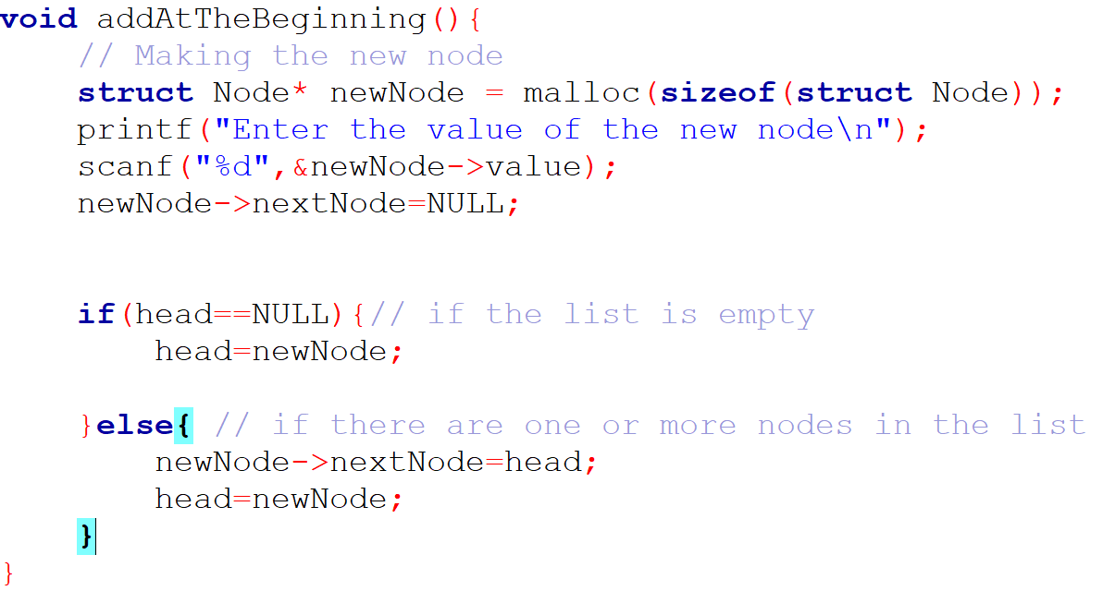
Linked List Insertion (At the beginning)
newNode

Slide 6
Linked List Insertion (At the beginning)
newNode
5

Slide 7
Linked List Insertion (At the beginning)
newNode
5
Null

Slide 8
Linked List Insertion (At the beginning)
newNode
5
Null
CASE 1: LIST IS EMPTY
head
Null

Slide 9
Linked List Insertion (At the beginning)
newNode
5
Null
CASE 1: LIST IS EMPTY
head
newNode
5
Null

Slide 10
Linked List Insertion (At the beginning)
CASE 2: LIST IS NO LONGER EMPTY
head
5
Null

Slide 11
Linked List Insertion (At the beginning)
CASE 2: LIST IS NO LONGER EMPTY
newNode
15
Null
head
5
Null

Slide 12
Linked List Insertion (At the beginning)
CASE 2: LIST IS NO LONGER EMPTY
newNode
15
Null
head
5
Null

Slide 13
Linked List Insertion (At the beginning)
CASE 2: LIST IS NO LONGER EMPTY
newNode
15
Null
head
5
Null

Slide 14
Linked List Insertion (At the beginning)
CASE 2: LIST IS NO LONGER EMPTY
newNode
15
head
5
Null

Slide 15
Linked List Insertion (At the beginning)
CASE 2: LIST IS NO LONGER EMPTY
newNode
15
head
5
Null

Slide 16
Linked List Insertion (At the beginning)
CASE 2: LIST IS NO LONGER EMPTY
head
15
5
Null

Slide 17
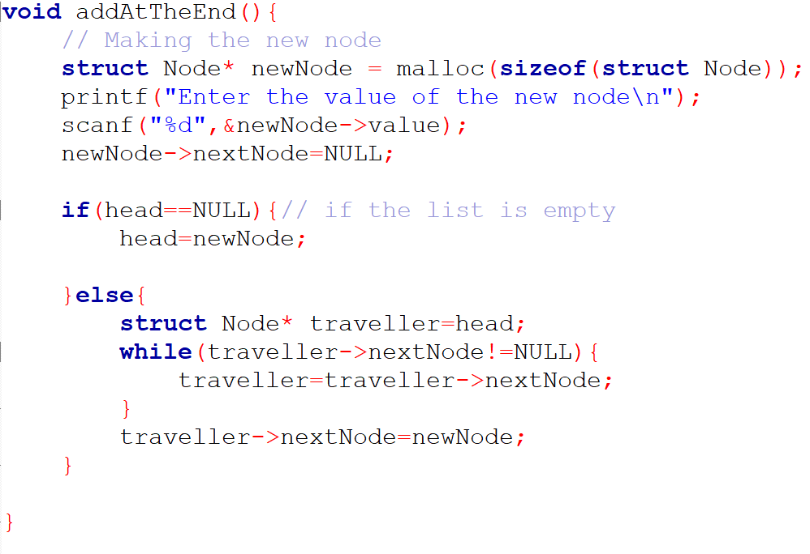
Linked List Insertion (At the End)
CASE 1: THE LIST IS EMPTY

Slide 18
Linked List Insertion (At the End)
CASE 1: THE LIST IS EMPTY
(exactly like before)

Slide 19
Linked List Insertion (At the End)
CASE 2: THE LIST IS NOT EMPTY
head
3
15
5
Null

Slide 20
Linked List Insertion (At the End)
CASE 2: THE LIST IS NOT EMPTY
newNode
Null
10
head
3
15
5
Null

Slide 21
Linked List Insertion (At the End)
CASE 2: THE LIST IS NOT EMPTY
newNode
Null
10
traveller
head
3
15
5
Null

Slide 22
Linked List Insertion (At the End)
CASE 2: THE LIST IS NOT EMPTY
newNode
Null
10
traveller
head
3
15
5
Null

Slide 23
Linked List Insertion (At the End)
CASE 2: THE LIST IS NOT EMPTY
newNode
Null
10
traveller
head
3
15
5
Null

Slide 24
Linked List Insertion (At the End)
CASE 2: THE LIST IS NOT EMPTY
newNode
Null
10
traveller
head
3
15
5
Null

Slide 25
Linked List Insertion (At the End)
CASE 2: THE LIST IS NOT EMPTY
newNode
Null
10
traveller
head
3
15
5
Null

Slide 26
Linked List Insertion (At the End)
CASE 2: THE LIST IS NOT EMPTY
newNode
Null
10
traveller
head
3
15
5
Null

Slide 27
Linked List Insertion (At the End)
CASE 2: THE LIST IS NOT EMPTY
newNode
Null
10
traveller
head
3
15
5
Null

Slide 28
Linked List Insertion (At the End)
CASE 2: THE LIST IS NOT EMPTY
newNode
Null
10
traveller
head
3
15
5

Slide 29
Linked List Insertion (At the End)
CASE 2: THE LIST IS NOT EMPTY
head
3
15
5
10
Null

Slide 30
Linked List Insertion (After a particular Node)

Slide 31
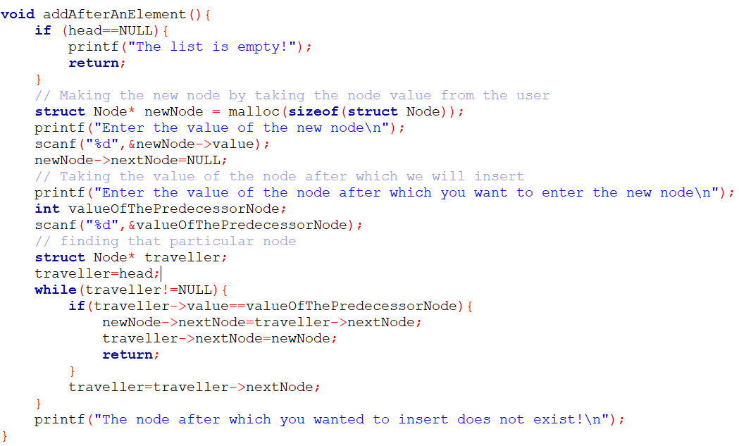
Linked List Insertion (After a particular Node)

Slide 32
Linked List Insertion (After a particular Node)
CASE 1: LIST IS EMPTY
head
Null

Slide 33
Linked List Insertion (After a particular Node)
CASE 2: LIST IS NOT EMPTY & ELEMENT EXISTS

Slide 34
Linked List Insertion (After a particular Node)
CASE 2: LIST IS NOT EMPTY & ELEMENT EXISTS
newNode
Null
10
head
3
15
5
Null

Slide 35
Linked List Insertion (After a particular Node)
CASE 2: LIST IS NOT EMPTY & ELEMENT EXISTS
newNode
Null
10
Assume that we want to insert after 15
head
3
15
5
Null

Slide 36
Linked List Insertion (After a particular Node)
CASE 2: LIST IS NOT EMPTY & ELEMENT EXISTS
newNode
Null
10
traveller
head
3
15
5
Null

Slide 37
Linked List Insertion (After a particular Node)
CASE 2: LIST IS NOT EMPTY & ELEMENT EXISTS
newNode
Null
10
traveller
head
3
15
5
Null

Slide 38
Linked List Insertion (After a particular Node)
CASE 2: LIST IS NOT EMPTY & ELEMENT EXISTS
newNode
Null
10
traveller
head
3
15
5
Null

Slide 39
Linked List Insertion (After a particular Node)
CASE 2: LIST IS NOT EMPTY & ELEMENT EXISTS
newNode
Null
10
traveller
head
3
15
5
Null

Slide 40
Linked List Insertion (After a particular Node)
CASE 2: LIST IS NOT EMPTY & ELEMENT EXISTS
newNode
Null
10
traveller
head
3
15
5
Null

Slide 41
Linked List Insertion (After a particular Node)
CASE 2: LIST IS NOT EMPTY & ELEMENT EXISTS
newNode
Null
10
traveller
head
3
15
5
Null

Slide 42
Linked List Insertion (After a particular Node)
CASE 2: LIST IS NOT EMPTY & ELEMENT EXISTS
newNode
Null
10
traveller
head
3
15
5
Null

Slide 43
Linked List Insertion (After a particular Node)
CASE 2: LIST IS NOT EMPTY & ELEMENT EXISTS
newNode
Null
10
traveller
head
3
15
5
Null

Slide 44
Linked List Insertion (After a particular Node)
CASE 2: LIST IS NOT EMPTY & ELEMENT EXISTS
newNode
10
traveller
head
3
15
5
Null

Slide 45
Linked List Insertion (After a particular Node)
CASE 2: LIST IS NOT EMPTY & ELEMENT EXISTS
newNode
10
traveller
head
3
15
5
Null

Slide 46
Linked List Insertion (After a particular Node)
CASE 2: LIST IS NOT EMPTY & ELEMENT EXISTS
newNode
10
traveller
head
3
15
5
Null

Slide 47
Linked List Insertion (After a particular Node)
CASE 2: LIST IS NOT EMPTY & ELEMENT EXISTS
newNode
10
traveller
head
3
15
5
Null

Slide 48
Linked List Insertion (After a particular Node)
CASE 2: LIST IS NOT EMPTY & ELEMENT EXISTS
head
3
15
10
5
Null

Slide 49
Linked List Insertion (After a particular Node)
CASE 3: LIST IS NOT EMPTY &
DOES NOT ELEMENT EXISTS
newNode
Null
1
head
3
15
10
5
Null

Slide 50
Linked List Insertion (After a particular Node)
CASE 3: LIST IS NOT EMPTY &
DOES NOT ELEMENT EXISTS
newNode
Null
1
head
3
15
10
5
Null
Assume that we want to insert after 16
Clearly 16 does not exist

Slide 51
Linked List Insertion (After a particular Node)
CASE 3: LIST IS NOT EMPTY &
DOES NOT ELEMENT EXISTS
newNode
Null
1
traveller
head
3
15
10
5
Null
Assume that we want to insert after 16
Clearly 16 does not exist

Slide 52
Linked List Insertion (After a particular Node)
CASE 3: LIST IS NOT EMPTY &
DOES NOT ELEMENT EXISTS
newNode
Null
1
traveller
head
3
15
10
5
Null
Assume that we want to insert after 16
Clearly 16 does not exist

Slide 53
Linked List Insertion (After a particular Node)
CASE 3: LIST IS NOT EMPTY &
DOES NOT ELEMENT EXISTS
newNode
Null
1
traveller
head
3
15
10
5
Null
Assume that we want to insert after 16
Clearly 16 does not exist

Slide 54
Linked List Insertion (After a particular Node)
CASE 3: LIST IS NOT EMPTY &
DOES NOT ELEMENT EXISTS
newNode
Null
1
traveller
head
3
15
10
5
Null
Assume that we want to insert after 16
Clearly 16 does not exist

Slide 55
Linked List Insertion (After a particular Node)
CASE 3: LIST IS NOT EMPTY &
DOES NOT ELEMENT EXISTS
newNode
Null
1
traveller
head
3
15
10
5
Null
Assume that we want to insert after 16
Clearly 16 does not exist

Slide 56
Linked List Insertion (After a particular Node)
CASE 3: LIST IS NOT EMPTY &
DOES NOT ELEMENT EXISTS
newNode
Null
1
traveller
head
3
15
10
5
Null
Assume that we want to insert after 16
Clearly 16 does not exist

Slide 57
Linked List Insertion (After a particular Node)
CASE 3: LIST IS NOT EMPTY &
DOES NOT ELEMENT EXISTS
newNode
Null
1
traveller
head
3
15
10
5
Null
Assume that we want to insert after 16
Clearly 16 does not exist

Slide 58
Linked List Insertion (After a particular Node)
CASE 3: LIST IS NOT EMPTY &
DOES NOT ELEMENT EXISTS
newNode
Null
1
traveller
head
3
15
10
5
Null
Assume that we want to insert after 16
Clearly 16 does not exist

Slide 59
Linked List Insertion (After a particular Node)
CASE 3: LIST IS NOT EMPTY &
DOES NOT ELEMENT EXISTS
newNode
Null
1
traveller
head
3
15
10
5
Null
Assume that we want to insert after 16
Clearly 16 does not exist

Slide 60
Linked List Insertion (After a particular Node)
CASE 3: LIST IS NOT EMPTY &
DOES NOT ELEMENT EXISTS
newNode
Null
1
traveller
head
3
15
10
5
Null
Assume that we want to insert after 16
Clearly 16 does not exist

Slide 61
Linked List Insertion (After a particular Node)
CASE 3: LIST IS NOT EMPTY &
DOES NOT ELEMENT EXISTS
newNode
Null
1
traveller
head
3
15
10
5
Null
Assume that we want to insert after 16
Clearly 16 does not exist

Slide 62
Linked List Insertion (After a particular Node)
CASE 3: LIST IS NOT EMPTY &
DOES NOT ELEMENT EXISTS
newNode
Null
1
traveller
head
3
15
10
5
Null
Assume that we want to insert after 16
Clearly 16 does not exist

Slide 63
Linked List Insertion (After a particular Node)
CASE 3: LIST IS NOT EMPTY &
DOES NOT ELEMENT EXISTS
newNode
Null
1
traveller
head
3
15
10
5
Null
Assume that we want to insert after 16
Clearly 16 does not exist

Slide 64
Linked List Insertion (After a particular Node)
CASE 3: LIST IS NOT EMPTY &
DOES NOT ELEMENT EXISTS
newNode
Null
1
traveller
head
3
15
10
5
Null
Assume that we want to insert after 16
Clearly 16 does not exist

Slide 65
Linked List Insertion (After a particular Node)
CASE 3: LIST IS NOT EMPTY &
DOES NOT ELEMENT EXISTS
newNode
Null
1
traveller
head
3
15
10
5
Null
Assume that we want to insert after 16
Clearly 16 does not exist

Slide 66
Linked List Insertion (After a particular Node)
CASE 3: LIST IS NOT EMPTY &
DOES NOT ELEMENT EXISTS
head
3
15
10
5
Null

Slide 67
Deletion in a linked list

Slide 68
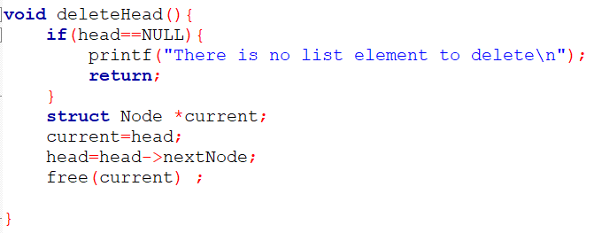
Deletion at the beginning

Slide 69
Deletion at the beginning
Case 1: The list is empty
head
Null

Slide 70
Deletion at the beginning
Case 1: The list is empty
head
Null

Slide 71
Deletion at the beginning
Case 2: The list is NOT empty
head
3
15
5
Null

Slide 72
Deletion at the beginning
Case 2: The list is NOT empty
head
3
15
5
Null
current

Slide 73
Deletion at the beginning
Case 2: The list is NOT empty
head
3
15
5
Null
current

Slide 74
Deletion at the beginning
Case 2: The list is NOT empty
head
3
15
5
Null
current

Slide 75
Deletion at the beginning
Case 2: The list is NOT empty
head
3
15
5
Null
current

Slide 76
Deletion at the beginning
Case 2: The list is NOT empty
head
3
15
5
Null
current

Slide 77
Deletion at the beginning
Case 2: The list is NOT empty
head
15
5
Null
current

Slide 78
Deletion at the beginning
Case 2: The list is NOT empty
head
15
5
Null

Slide 79
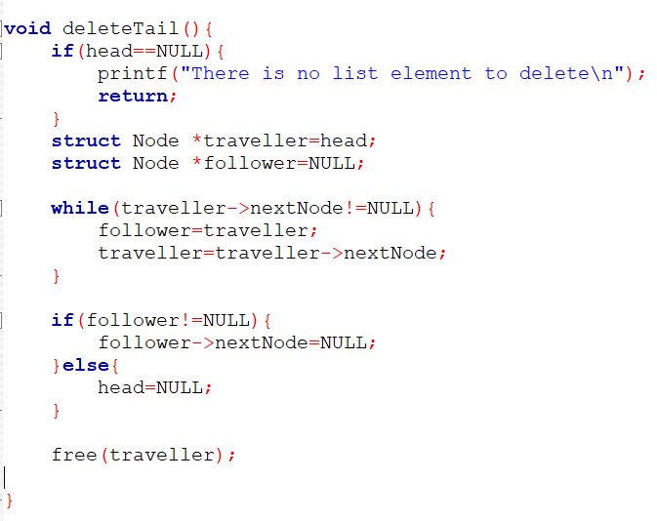
Deletion at the End
Case 1: The list is empty
head
Null

Slide 80
Deletion at the End
Case 2: The list is not empty

Slide 81
Deletion at the End
Case 2: The list is not empty
And there are many
Elements in the list
head
3
15
10
5
Null

Slide 82
Deletion at the End
Case 2: The list is not empty
And there are many
Elements in the list
traveller
head
3
15
10
5
Null

Slide 83
Deletion at the End
Case 2: The list is not empty
And there are many
Elements in the list
follower
traveller
Null
head
3
15
10
5
Null

Slide 84
Deletion at the End
Case 2: The list is not empty
And there are many
Elements in the list
follower
traveller
Null
head
3
15
10
5
Null

Slide 85
Deletion at the End
Case 2: The list is not empty
And there are many
Elements in the list
follower
traveller
Null
head
3
15
10
5
Null

Slide 86
Deletion at the End
Case 2: The list is not empty
And there are many
Elements in the list
follower
traveller
head
3
15
10
5
Null

Slide 87
Deletion at the End
Case 2: The list is not empty
And there are many
Elements in the list
follower
traveller
head
3
15
10
5
Null

Slide 88
Deletion at the End
Case 2: The list is not empty
And there are many
Elements in the list
follower
traveller
head
3
15
10
5
Null

Slide 89
Deletion at the End
Case 2: The list is not empty
And there are many
Elements in the list
follower
traveller
head
3
15
10
5
Null

Slide 90
Deletion at the End
Case 2: The list is not empty
And there are many
Elements in the list
follower
traveller
head
3
15
10
5
Null

Slide 91
Deletion at the End
Case 2: The list is not empty
And there are many
Elements in the list
follower
traveller
head
3
15
10
5
Null

Slide 92
Deletion at the End
Case 2: The list is not empty
And there are many
Elements in the list
follower
traveller
head
3
15
10
5
Null

Slide 93
Deletion at the End
Case 2: The list is not empty
And there are many
Elements in the list
follower
traveller
head
3
15
10
5
Null

Slide 94
Deletion at the End
Case 2: The list is not empty
And there are many
Elements in the list
traveller
follower
head
3
15
10
5
Null

Slide 95
Deletion at the End
Case 2: The list is not empty
And there are many
Elements in the list
traveller
follower
head
3
15
10
5
Null

Slide 96
Deletion at the End
Case 2: The list is not empty
And there are many
Elements in the list
traveller
follower
head
3
15
10
5
Null

Slide 97
Deletion at the End
Case 2: The list is not empty
And there are many
Elements in the list
traveller
follower
head
3
15
10
5
Null
Null

Slide 98
Deletion at the End
Case 2: The list is not empty
And there are many
Elements in the list
traveller
follower
head
3
15
10
Null

Slide 99
Deletion at the End
Case 2: The list is not empty
And there are many
Elements in the list
head
3
15
10
Null

Slide 100
Deletion at the End
Case 3: The list is not empty
And there is only one element
follower
traveller
head
Null
3

Slide 101
Deletion at the End
Case 3: The list is not empty
And there is only one element
follower
traveller
head
Null
3

Slide 102
Deletion at the End
Case 3: The list is not empty
And there is only one element
follower
traveller
head
Null
3

Slide 103
Deletion at the End
Case 3: The list is not empty
And there is only one element
follower
traveller
head
Null
3
Null

Slide 104
Deletion at the End
Case 3: The list is not empty
And there is only one element
follower
traveller
head
Null

Slide 105
Deletion at the End
Case 3: The list is not empty
And there is only one element
head
Null

Slide 106
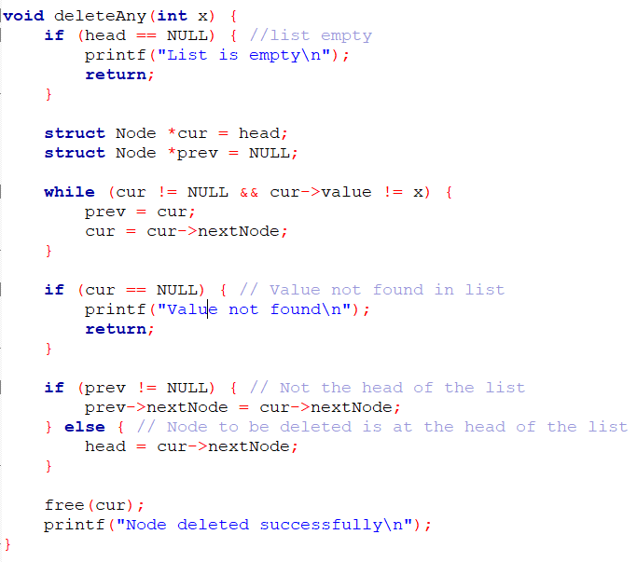
Deleting a Node with a particular value
Case 1: The element is not there
(assume we want to delete 11)
head
3
15
10
5
Null

Slide 107
Deleting a Node with a particular value
Case 2: The element is there
(assume we want to delete 10)
head
3
15
10
5
Null

Slide 108
Deleting a Node with a particular value
Case 3: The element is there at the beginning
(assume we want to delete 3)
head
3
15
10
5
Null

Slide 109
Thank You

